Slide 1
Pixel Images
Mack 2021

Slide 2
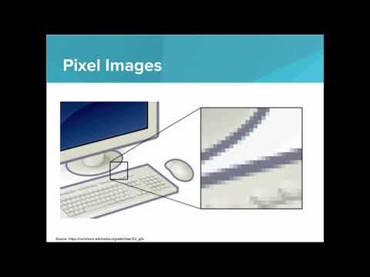
We learn how images are made up of pixels, and how each pixel can be encoded by a numeric value. We learn how to make black and white images from bits.

Slide 3
What is a pixel?
Notes:
🍐 This is a Pear Deck Multiple Choice Slide. Your current options are: A: A grid of several colors in a digital image, B: Another name for a digital image, C: A single tiny dot, or square, of color in a digital image., D: A small picture,
🍐 To edit the type of question or choices, go back to the "Ask Students a Question" in the Pear Deck sidebar.
C

Slide 4

Practice: Checkerboard
Using the pixel tool, type out the binary encoding for a black and white checkerboard.
The result should look like this:

Slide 5
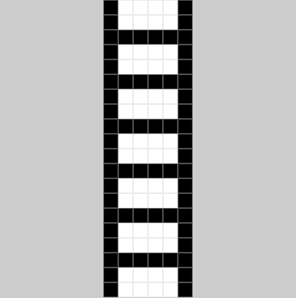
Practice: Ladder
In this exercise, create an image of a ladder that has a height of 20 and a width of 6. The resulting image should look similar to this:

Slide 6
Practice: Create an Image!
You have a blank canvas, create whatever image you’d like!
Play around with the width and height as well, not all images need to be square!
Have fun!

